Slide 1

Servos
Pete Januarius – June 2019

Slide 2
Goals
Success Criteria
Understand what a servo is
Build a servo circuit with Arduino
Code the circuit and experiment
Able to explain what a servo is
Working servo circuits
Able to explain how the code works

Slide 3
What is a Servo?
A servo is like a motor but it isn’t a motor. Whilst it has a motor inside it, the real purpose of a servo is to control movement of an output shaft to a precise angle. Have you ever flown on a plane? How do you think the rudders and ailerons move so precisely? On model planes it is usually with servos!
This is the SG90 Tower Pro servo. You will be using several of these to make Otto’s arms and legs work

Slide 4
Servo - A detailed look
The output shaft is controlled with a precise signal sent to the servo. The shaft turns from 0 – 180 degrees and back again

Slide 5
SG90 – Detailed Look
Check out the cogs !

Slide 6

Servo – Video how to

Slide 7
Servos in Action (1)
This is an Arduino based robot arm ! Full of servos !

Slide 8
Servos in Action (2)
This servo has been adapted to use with lego !! Forget Mindstorms and build your own !

Slide 9
Servos in Action (3)
The Ottobot Minion by @CoolTrish has 6 servos. Can you guess where they are?

Slide 10
Wiring up the Sweep Project

Slide 11
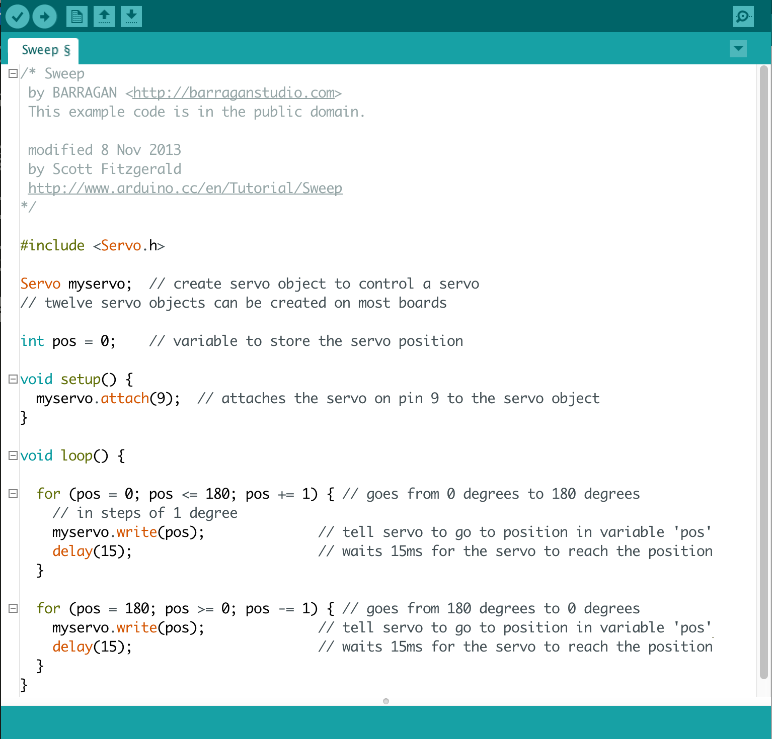
The Sweep Project Code

Slide 12
How do for...loops work?
A for...loop is used in code to repeat an action
many times. We can use them to change the
angle of a servo – say from 0 to 180 degrees
over a certain period of time. A for...loop looks
like this....
for ( i = 0; i <= 180; i += 1) {
Serial.println(i)
}
‘i’ is the counter. It has a start value of 0
‘i += 1’ adds one to ’i’ for every iteration of the loop
‘i <= 180’ is the test to check if the counter has reached 180 yet

Slide 13
Challenge Project
Can you create a similar project to your Arduino servo project that you just built. In this version, however, control of the servo will light up one or more LEDs and turn them off accordingly !
Maybe not as many as the project to the left in the image !

Slide 14


